Slide 1

Capstone Project – Online Retail Analysis
Marten Seer

Slide 2
Introduction
Transnational dataset containing transactions occurring between 01/12/2010 and 09/12/2011
UK-based non-store online retail
Dates are invoice dates
Sells unique all-occasion gifts
Many customers are wholesalers

Slide 3
Key Performance Indicators
Revenue £9,756,809
Total Orders 534,726
# of Units Ordered 5,288,855
Average Order Price £18.25
Average Order Size 10 units
# of Unique Countries
38

Slide 4
Distribution of Sales per Month
Most successful months
October – £1,06M in sales; 59,955 orders; Halloween
November - £1,43M in sales; 83,765 orders; Black Friday, Christmas period
Most purchases are done two weeks before holidays
Reason could be wholesalers
December 2011 was incomplete, but could be compared to last year’s
December 2010 same period 9% larger revenue
December 2010 whole period 58% of revenue achieved

Slide 5
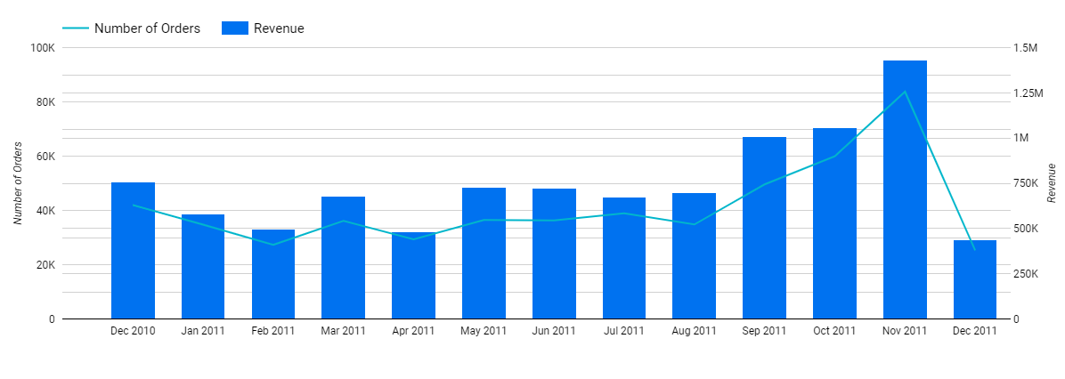
Monthly Sales Trend
Seasonality can be suspected

Slide 6

Countries
United Kingdom is largest
85% of total revenue
92% of total orders
Netherlands 2nd revenue wise, but 5th in terms of number of orders placed
3% of total revenue
Placed orders in large quantities

Slide 7
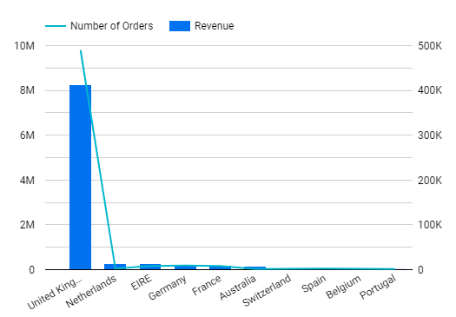
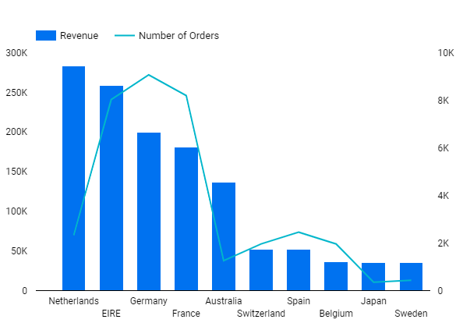
Countries

Slide 8
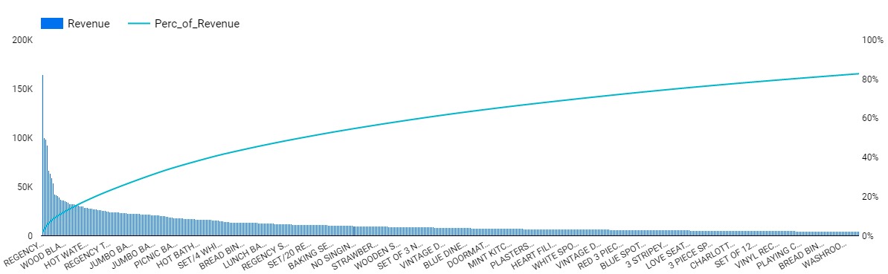
Pareto Chart for Products
Pareto Principle 80/20 did not work
12.6% of products = 80% of revenue
Top 500 products
Focus on only these – showcase them more prominently
Majority of products are not interesting – could be removed
Color selection could be moved
Save money on operations and warehousing
Problem could be website – people can’t find these products

Slide 9
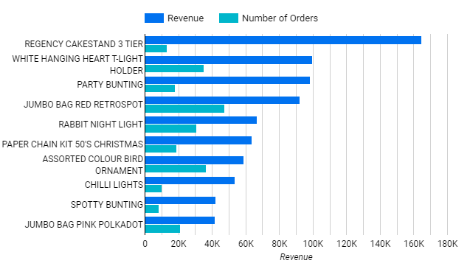
Best Performing Products
Average price £3.28
Cake stand - 2% of total revenue
Top 10 produce 9% of total revenue

Slide 10
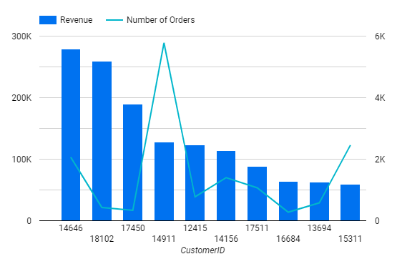
Top 10 Customers
Most of the customers from UK
Top customer from Netherlands
98% of Netherlands’ sales
3% of total sales
Unfortunately, dataset does not provide names nor regions

Slide 11
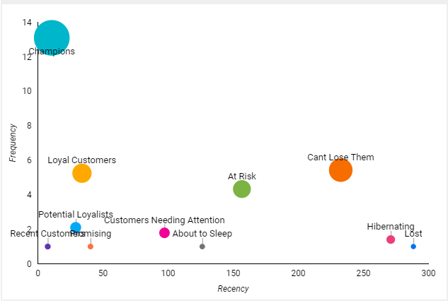
Customers
RFM Analysis
Champions were most valuable
Largest segment – 22% of customers
Potential segments to become loyal customers
“At Risk”, “Can’t Lose Them”, “Customers Needing Attention”
Large segments, high average monetary

Slide 12
Recommendations
Focus on international sales
Countries near UK generate higher revenue
Can be sold to anyone
Potentially tap into a larger customer base, increase the revenue (France, Germany)
Right payment methods
50% of customers are likely to abandon their shopping cart when they don’t see familiar payment method
Language of country
55% of customers prefer to buy in their own language
Penetration pricing

Slide 13
Recommendations
For retaining customers there are two approaches
Revenue focused – Focus on Champions only
Personalized offers
Price skimming or premium pricing strategy
Acquiring new customers
Bundle pricing
Competitive pricing to acquire from competitor

Slide 14
Recommendations
Focus on top 500 products which produce the majority of revenue
Save money on poorly performing products by narrowing product/color selection
Get behind the reason why they are not performing well
People can’t find those products on their website?

Slide 15
Recommendations
Three weeks before the bigger holidays are the busiest
Two weeks before the smaller holidays are the busiest
Inventory needs to be stocked up
Campaigns need to be launched
Distribution by month, by week and by day can help to optimize store’s operations

Slide 16
Thank You for Your Attention!

